Slide 1
Agenda
Dec 7 (Wednesday)
Review Units 1, 2, and 3
Begin on File System Simulator
Dec 9 (Friday)
Review Unit 4
File System Simulator Discussion / Demos
Dec 12 (Monday)
Review Units 5 & 6
File System Simulator Discussion / Demos
Dec 14 (Wednesday)
Final Exam

Slide 2
Final Review - Part 1
12/7/2022

Slide 3
Final Review - Part 1
Unit 1
Unit 2
Unit 3
Begin on File System Simulator

Slide 4
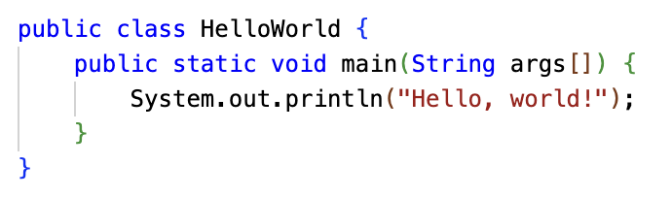
1.1 Do we look at this through new eyes?
System.out.print("Hello, world!"); //prints on one continuous line
System.out.println("Hello, world!"); //adds a new line after printing

Slide 5
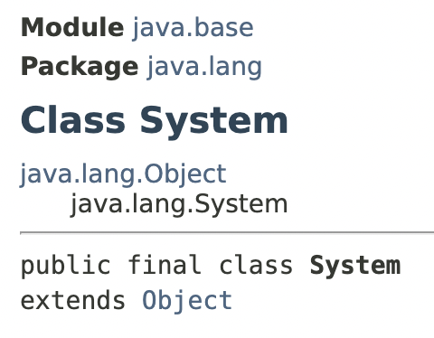
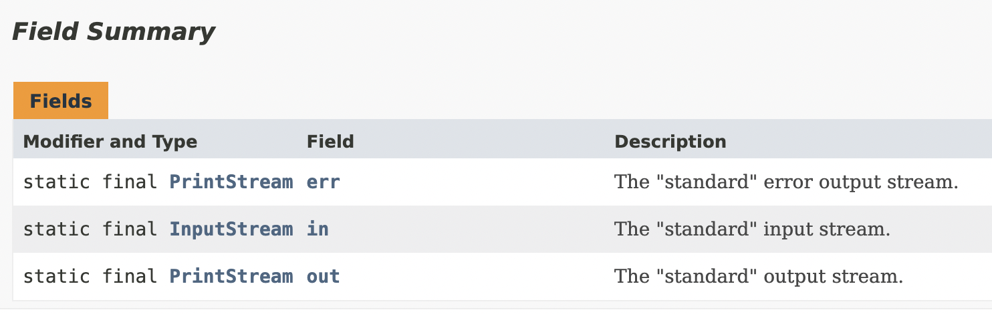
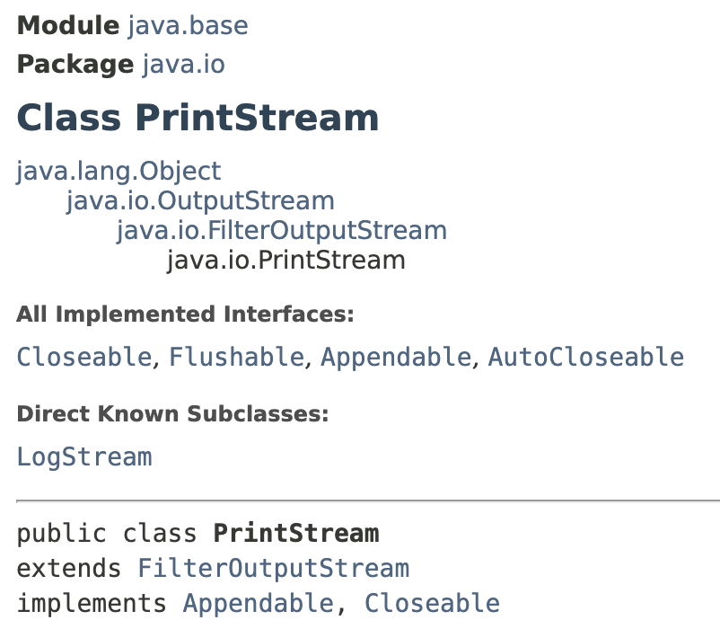
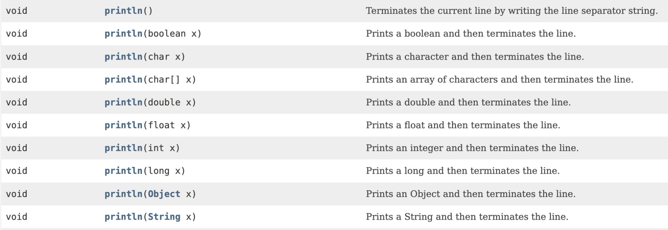

Slide 6
1.3 Variables and Types
A variable is a named value located in computer memory. Its value may vary, because it can be assigned to repeatedly.
A variable is declared to be one of Java's data types.
The convention is variables in Java are named using camelCase.
default value
boolean stillPlaying; false
char ch; 0
double price; 0
float ratio; 0
int i; 0
long l; 0
String s; null
Variables
may optionally be initialized:
boolean stillPlaying = false;
char ch = 'A';
double price = 3.95;
float ratio = 2.3f;
int i = 0;
long l = 120000000;
String s = "Hello";

Slide 7
Java's primitive data types
boolean
true or false
1 bit (in practice, often padded to 1 byte or more)
byte
integer in range -128..127
1 byte (8 bits)
char
Unicode character
2 bytes (16 bits)
short
integer in range -32768..32767
2 bytes (16 bits)
int
integer in range -2,147,483,648 to 2,147,483,647
4 bytes (32 bits)
float
single-precision floating point number, up to ~6-7 decimal digits
4 bytes (32 bits)
long
integer -9,223,372,036,854,775,808 to 9,223,372,036,854,775,807
8 bytes (64 bits)
double
double-precision floating point number, up to ~15 decimal digits
8 bytes (64 bits)
float and double also have special values: Infinity, -Infinity, NaN (Not a Number)

Slide 8
Java object reference types
The size of an object reference is up to the Java implementation, but on today's computers, it's usually 4 or 8 bytes. It depends on the CPU, operating system, and JVM being used and its configuration.
4 bytes (32 bits)
8 bytes (64 bits)
Like everything on computers, it's a number in the end.
You never see the actual number though... Java hides it from you, as an abstraction.
You can think of computer memory as a giant array, and as an object reference as an index into that array. (It's a bit more complicated but that's the basic idea.) null is usually represented by 0.

Slide 9
Variable Names
Variable names must start with a letter. The rest of the name may include letters, digits, or _.
No spaces!
The convention is camelCase with the first letter in lowercase.
Variable names should be descriptive!
* Keywords are off limits (for, if, class, double, static, int, etc.)

Slide 10
Keyword final
The keyword final can be used in front of a variable declaration to make it a constant that cannot be changed. Constants are traditionally capitalized.
Syntax:
final type NAME = value;
EX:
final double PI = 3.14;

Slide 11
The String Concatenation Operator (+)
Same symbol as addition
Used to combine Strings and other data types into a result String
System.out.println("Hello, " + " friend!");
Will print out: Hello, friend!
System.out.println("Your score: " + 100);
Will print out: Your score: 100
// Variables can be included in the concatenation
int score = 500; System.out.println("Your score: " + score); Will print out: Your score: 500

Slide 12
1.4 Expressions
A combination of constants, variables, operators and method calls that evaluate to a value.
Examples:
11 * 3 + 5 - 8 / 4
100
x * 10
radius * Math.sin(angle * Math.PI / 180.0)

Slide 13
Assignment vs Equals
Assignment
Equality
x = 0
x == 0

Slide 14
Arithmetic Operators
Operator | Meaning | Example
+ | addition | 3 + x
- | subtraction | p - q
* | multiplication | 6 * i
/ | division | 10 / 4
% | modulo (remainder) | 11 % 3

Slide 15

Order of Operations
Java evaluates expressions according to standard mathematical rules of precedence.
PEMDAS
Parentheses
Exponent (ignore this for now)
Multiply / Divide / Modulus
Addition / Subtraction
Note that Java evaluates expressions from left to right and from top to bottom.

Slide 16
Division
Dividing two int values results in a single int (always truncated: rounded down)
10 / 2 = 5 15 / 2 = 7 19 / 10 = 1
Dividing with a double results in a double
15 / 2.0 = 7.5
Casting can be used to force double division:
int x = 9, y = 2;
double z = (double)x / y;

Slide 17
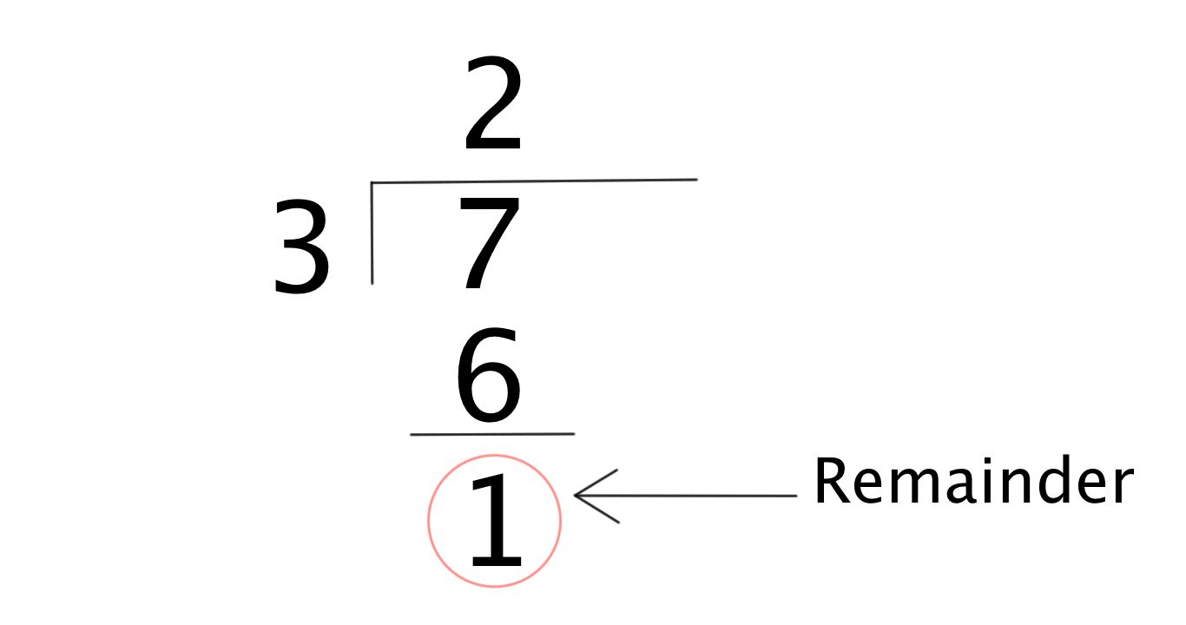
Modulo
The modulo operator (%) gives the remainder to an equivalent division problem. It's used most on ints, but also works on floats/doubles.
7 % 3
4 % 2
3 % 5
== 1
== 0
== 3
Check if a number is even or odd:
x % 2 == 0 means x is even
x % 2 == 1 means x is odd
Check if a number is a multiple of another:
x % y == 0 means x is a multiple of y (divisible by y with a remainder of 0)

Slide 18
String Concatenation
Once Java starts working with Strings, it continues to look at thing as strings and interpret “+” operator as string concatenation operator.
Examples
"Lucky number: " + 4 + 2
4 + 2 + " is lucky"
== "Lucky number: 42"
== "6 is lucky"

Slide 19
1.5 Compound Assignment Operators
These shortcuts let you do assignment and a math operation in one step
Example Expression | Shortcut form!
x = x + 3 | x += 3
x = x - y | x -= y
x = x * 5.0 | x *= 5.0
x = x / 2 | x /= 2
x = x % 3 | x %= 3

Slide 20
Incrementing Compound Operators
Adding 1 and Subtracting 1 to a variable are so commonly used, that Java has special expressions for these operations.
Expression | Shortcut form | Even Shorter Shortcut Form
x = x + 1 | x += 1 | x++
y = y - 1 | y -= 1 | y--
Note: You can also do ++x or --x. This would adjust the value of x before doing something with it. This is not on the AP exam but here’s an example:
int x = 6;
int y = ++x;
System.out.println(x) // Outputs 7
System.out.println(y) // Outputs 7
int x = 6;
int y = x++;
System.out.println(x) // Outputs 7
System.out.println(y) // Outputs 6

Slide 21
1.6 User Input
java.util.Scanner reads input from a stream. One stream you can read is System.in, which is usually connected to the user's keyboard!
import java.util.Scanner;
public class Demo {
public static void main(String[] args) {
Scanner scanner = new Scanner(System.in); System.out.println("What is your name?"); String name = scanner.nextLine(); System.out.println("Well, hello, " + name + "!");
}
}

Slide 22
If we want to do calculations, we need numeric input. To take numeric values as input from a Scanner, we can call different methods:
Scanner scan = new Scanner(System.in);
int x = scan.nextInt();
double y = scan.nextDouble();
scan.nextLine(); // Get past the newline
The final call to nextLine() is needed because scan.nextInt() and scan.nextDouble() read "tokens" from input but don't parse the newline.
Alternately, you could read strings in with scan.nextLine() and convert them to the desired types, using Integer.parseInt, Double.parseDouble, etc.

Slide 23
1.6 Promotion of values
Java will promote values from certain data types to certain other data types when used together.
int + double = double
int + String = String
double + String = String

Slide 24
1.6 Casting
(int) 4.29 ⇒ 4
(double) 1 ⇒ 1.0
Note: String is not a primitive type and cannot be cast. Java will convert int and double to strings when concatenated with a string.
"" + 4.892 ⇒ "4.892"
Notes:
Promoting is implicitly changing the types, but you can (and should for clarity and ease of troubleshooting) explicitly convert types using casting.
Make sure they understand that they type the parenthesis before the value.

Slide 25
2.1 Classes and Objects
CLASS | OBJECT (aka INSTANCE)
A class is a blueprint from which you can create the instance, i.e., objects. | An object is the instance of the class, which helps programmers to use variables and methods from inside the class.
Classes have logical existence. | Objects have a physical existence.
A class doesn't take any memory spaces when a programmer creates one. (The “idea” of a cat) | An object takes memory when a programmer creates one. (A real, live cat)
The class has to be declared only once. (i.e. “Cat”) | Objects can be declared several times depending on the requirement. (i.e. “Buttons”, “Mr. Bigglesworth”, “Garfield”)

Slide 26
Class
Object
String
String greeting = “Hello world!”;
String favoriteClass = “AP Computer Science”;
String bestTeacher = “Ms. Molina”;
Notes:
Car Example
4 Door Sedan -> Three different instances of that sedan

Slide 27
Attributes (instance variable) and Behaviors (methods)
An attribute or instance variable is data the object knows about itself. For example a turtle object knows the direction it is facing or its color.
A behavior or method is something that an object can do. For example a turtle object can go forward 100 pixels.

Slide 28
2.2 Constructors
public class Dog {
private String breed;
private int age;
private String color;
public Dog() {
breed = “pug”;
age = 3;
color = “brown”;
}
public Dog(String a, int b, String c) {
breed = a;
age = b;
color = c;
}
}
Default constructor
An overloaded constructor that takes parameters

Slide 29
World world1 = new World(); // creates a 640x480 world
World world2 = new World(300,400); // creates a 300x400 world
Turtle t1 = new Turtle(world1);
Turtle t2 = new Turtle(50, 100, world1);
Notice here that the order of parameters matters

Slide 30
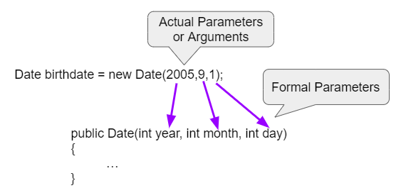
Formal and Actual Parameters
Date(2005,9,1) - This is call by value which means that copies of the actual parameter values are passed to the constructor. These values are used to initialize the object’s attributes.

Slide 31
2.3 Methods
A method is an action defined for a class that all instances of that class (objects) will support.
Methods can:
Provide access to an attribute of an instance
Update an attribute of an instance
Do something new and interesting with the information stored in an instance
Methods are called using the "." operator, which allows access to the public methods of a class.

Slide 32
Method declarations
Method declarations, such as public void makeOlder(int years) { … }
Define whether the method is accessible to the outside world (public / private)
Public methods are available externally (e.g. goodBoy.getAge()) while private methods are not (calling goodBoy.dogYears() in main will cause an error)
Determine what the method returns
Void methods return nothing
String methods promise to return Strings, int methods to return ints
Defines the variables (parameters) passed to the method
To be described in the next section
Define the body of the method
The body is the statements of code that will execute when the method is called.

Slide 33
Abstraction – keeping things simple
One of the core concepts in computer science is abstraction. Abstraction means that you only need to understand how to interact with an object–you don’t need to understand how the code is actually implemented behinds the scenes.
E.g. as a user, I should be indifferent between the following implementations:
Option 1
private int dogYears() {
return 7*age;
}
public int getAge() { return dogYears();
}
Option 2
public int getAge() {
return (age + age + age + age + age + age + age);
}
Option 3
public int getAge() {
return 7*age;
}

Slide 34
The power of abstraction
Abstraction accomplishes two things:
It keeps things simple, minimizing what you need to know to write a program
It makes it possible for the class owner to change the technical implementation of the method without impacting its use
e.g., option 3 may be faster for a computer to calculate than option 2… the programmer may want to switch their implementation from 2 to 3. Abstraction means that the user won’t notice a difference (besides faster code)

Slide 35
2.4 Method Parameters, Overloaded Methods
// Person.java
public class Person {
private String name;
public Person(String name) {
this.name = name;
}
// Greeting
public void greet() {
System.out.println(name + " says: Hello, world!");
}
// Greet a particular person
public void greet(String otherName) { System.out.println(name + " says: Hello, " + otherName + "!”);
} }
// TestPerson.java
public class TestPerson { public static void main(String[] args) { Person amy = new Person("Amy"); // Prints "Amy says: Hello, Ted!" amy.greet("Ted"); // Prints "Amy says: Hello, Thursday!" amy.greet("Thursday");
Person bob = new Person("Bob"); // Prints "Bob says: Hello, Amy!" bob.greet("Amy"); } }

Slide 36
2.5 Return Values
Methods can take inputs (“arguments” or “parameters”), and they can also spit out a single output (“return value”)
public double distance2D(double x1, double y1, double x2, double y2)
x1
distance2D method
y1
return value
x2
y2
Methods are like functions… what is the difference between a function and a method?

Slide 37
Return Value
Methods that don’t return anything have a void return type
public void printGreeting(String name) { System.out.println("Hello " + name + "!"); }

Slide 38
Return Value
The type of the return value must match what is declared in the method declaration
Right: public int getNumberTimesThree(int value) { return 3 * value; }
Wrong (why?): public int getNumberTimesThree(int value) { return 3.0 * value; }
Q: Java only lets you return one value from a method. How might you return multiple pieces of data at once?

Slide 39
Getter and Setter Methods
In Java, you’ll commonly find that classes declare getXYZ and setXYZ methods for their properties (instance variables).
public class TurtleTestGetSet { public static void main(String[] args) { World world = new World(300,300); Turtle yertle = new Turtle(world); System.out.println("Yertle's width is: " + yertle.getWidth()); // Yertle's width is: 15 (this is the default width) yertle.setWidth(200); yertle.setHeight(200); System.out.println("Yertle's width is: " + yertle.getWidth()); // Yertle's width is: 200 (this is the width after we’ve set it to 200 2 lines above yertle.turnRight(); world.show(true); } }
This is considered a best practice. Q: Why do you think that is?

Slide 40
toString Methods
In Java, all objects can be represented in String form by defining a toString method.
This can be useful for programmers to get a visual or textual representation of an otherwise abstract object.
How can we make the toString method to the right more descriptive?
What gets printed if you don't define a toString method?
class Student { private String name; private int age;
Student(String name, int age) { this.name = name; this.age = age; } public String toString(){ return name; } } class HelloWorld { public static void main( String args[] ) { Student s = new Student("Jane",16); System.out.println(s.toString()); //”Jane” System.out.println(s); //Also ”Jane” } }

Slide 41
2.6 Strings
Strings in Java are instances of the java.lang.String class that hold sequences of characters (a, b, c, $, etc.)
String s = “Hello, world!”;
String instance
s
0 | 1 | 2 | 3 | 4 | 5 | 6 | 7 | 8 | 9 | 10 | 11 | 12
H | e | l | l | o | , |  | w | o | r | l | d | !

Slide 42
Creating Strings
String is a class, so you can construct them with the new operator.
String s = new String(“Hello, world!”);
Strings can also be constructed using string literals:
String s = “Hello, world!”;

Slide 43
String comparison in Java
In many other languages, like JavaScript and Python, you can use the == operator to compare strings for equality.
In Java, the == operator compares object references, not what’s in the referenced objects!
s1.equals(s2) is almost always what you want, not s1 == s2

Slide 44

2.7 String Methods
int length() method returns the number of characters in the string, including spaces and special characters like punctuation.
String substring(int from, int to) method returns a new string with the characters in the current string starting with the character at the from index and ending at the character before the to index (if the to index is specified, and if not specified it will contain the rest of the string).
Remember: In Java, we always start counting from 0

Slide 45
String Methods
int indexOf(String str) method searches for the string str in the current string and returns the index of the beginning of str in the current string or -1 if it isn’t found.
int compareTo(String other) returns a negative value if the current string is less than the other string alphabetically, 0 if they have the same characters in the same order, and a positive value if the current string is greater than the other string alphabetically.
boolean equals(String other) returns true when the characters in the current string are the same as the ones in the other string. This method is inherited from the Object class, but is overridden which means that the String class has its own version of that method.

Slide 46
Mutable vs Immutable
Mutable: CAN CHANGE, Immutable: CANNOT CHANGE
Strings are immutable. Any methods that seems to change a string actually just creates a copy of it, and returns the new version as its return value. String str1 = "Hello!"; // Print str1 in lower case? Will str1 change? str1.toLowerCase(); System.out.println("In lowercase: " + str1);

Slide 47
Why are strings immutable?
Immutability is a powerful concept in Computer Science. It can make it easier to reason about what a program does.
When you pass a String to a method, since Strings are immutable, you know that the method cannot change your String behind your back!
s += ", world!"; is really the same as s = s + ", world";
(but is stylistically better)
Many modern programming languages have immutable strings, such as Python and JavaScript. Some chose to have mutable strings, like Ruby.

Slide 48
2.8 Wrapper classes
Wrapper classes are used to store primitive types inside of ordinary Java classes. Integer is a Java class, while int is not.
Integer has a single attribute storing the value of the int used to create the instance.
Constructors:
Integer i = new Integer(4); Double d = new Double(2.718);
Getters:
int j = i.intValue(); double e = d.doubleValue();

Slide 49
Wrapper classes
A variable whose type is a wrapper class like Integer, like any other class, is a reference to an object instance, not an object instance itself.
Using a wrapper class instead of a primitive type means more memory accesses, which is slower, and more memory used.
Wrapper object instances are also called "boxed primitives" – see the box?
Integer i = new Integer(4);
int j = 3;
Integer instance
i
3
j
3

Slide 50
Wrapper classes exist for every primitive type
Every primitive type in Java has a corresponding wrapper class.
boolean | java.lang.Boolean
byte | java.lang.Byte
char | java.lang.Character
double | java.lang.Double
float | java.lang.Float
int | java.lang.Integer
long | java.lang.Long
short | java.lang.Short

Slide 51
Autoboxing and unboxing
Originally, Java programmers had to explicitly convert between primitive types and the equivalent wrapper objects.
In Java 1.5 (released 9/30/2004), autoboxing and unboxing were added.
Autoboxing:
Integer i = 4; is the same as Integer i = new Integer(4);
Unboxing:
int j = i; is the same as int j = i.intValue();

Slide 52
Wrapper classes are immutable
The wrapper classes are immutable, like String. Once you create an instance of Integer, you can't change the int inside it.
The wrapper classes have getter methods like intValue(), doubleValue(), booleanValue(), floatValue(), but no setter methods.
Integer i = 3;
i = 5; ← This is really creating a whole new Integer object instance, and reassigning the value of i.

Slide 53
Why even use wrapper classes?
They contain useful methods and attributes:
Integer.parseInt(string) converts a string representation of an integer into an int
Integer.MIN_VALUE and Integer.MAX_VALUE store the largest and smallest possible 32-bit integers your computer can store. These lower and upper bounds on all computable integers are very useful in algorithm development
Storing primitive types within classes enables us to use Java language constructs that can only be applied to classes…
More on this later with Arrays and Maps

Slide 54
2.9 The Math Class
This class implements standard mathematical functions and constants.
Math has only static methods and attributes. It cannot be instantiated with the new operator… it has no public constructor!
public class Main {
public static void main(String args[]) { System.out.println(Math.PI); System.out.println(Math.sqrt(9)); } }
import static java.lang.Math.*;
public class Main {
public static void main(String args[]) { System.out.println(PI); System.out.println(sqrt(9)); } }

Slide 55
Math methods
static int abs(int x) | Returns the absolute value of an int value
static double abs(double x) | Returns the absolute value of a double value
static double sqrt(double x) | Returns the square root of a double value.
static double pow(double base, double exp) | Returns base^{exp}.

Slide 56
Random number
static double random()
Returns a double value greater than or equal to 0.0 and less than 1.
Example:
double randomValue = Math.random();
// Example output: 0.6573016382857277
// Generates a random int between 0 to 9 int random0To9 = (int) (Math.random() * 10);
// Generates a random int between 1 to 10 int random1To10 = (int) (Math.random() * 10) + 1;

Slide 57
3.1 Boolean Expressions
Relational Operators
x > y | true if x is greater than y, false otherwise
x < y | true if x is less than y, false otherwise
x >= y | true if x is greater than or equal to y, false otherwise
x <= y | true if x is less than or equal to y, false otherwise
x == y | true if x is equal to y, false otherwise
x != y | true if x is not equal to y, false otherwise
Tip: To remember >= and <=, think of it as the order in which you say it. Greater than (>) or equal to (=)

Slide 58
Relational Operators
x > y | true if x is greater than y, false otherwise
x < y | true if x is less than y, false otherwise
x >= y | true if x is greater than or equal to y, false otherwise
x <= y | true if x is less than or equal to y, false otherwise
x == y | true if x is equal to y, false otherwise
x != y | true if x is not equal to y, false otherwise
These don't work on objects, such as Strings! This is where you use the String.compareTo method.

Slide 59
3.2 if statement
Flowchart of if
if (boolean expression)
then-statement
Does boolean expression evaluate to true?
Example:
Yes
if (age >= 18) { System.out.println("You are eligible to vote!"); }
No
Execute then-statement
Legal, but not recommended:
if (age >= 18) System.out.println("You are eligible to vote!");
Next statement after if
then-statement can be any statement, and a { block } is a statement.
It's recommended to always use blocks with if.

Slide 60
3.3 if-else statement
Flowchart of if…else
Does boolean expression evaluate to true?
if (boolean expression)
then-statement
else
else-statement
No
Yes
Execute then-statement
Execute else-statement
The if statement has an optional else clause.
Example:
if (age >= 18) {
System.out.println("You are eligible to vote!");
} else {
System.out.println("You are too young to vote!");
}
Next statement after if…else

Slide 61
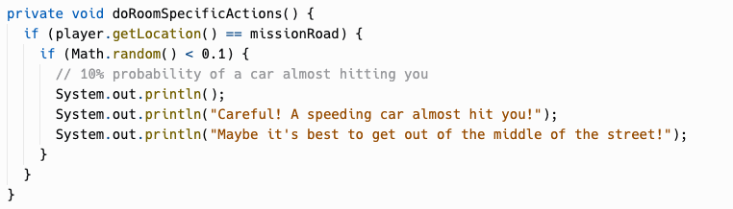
Nested If-Statements
if (boolean expression) {
if (boolean expression) {
if (boolean expression) {
<statement>;
<statement>;
…
} else {
<statement>;
<statement>;
…
}
}
} else {
<statement>;
<statement>;
…
}

Slide 62
Dangling Else
int x = 0;
if (x >= 0)
if (x > 0)
System.out.println(“x is positive”);
else
System.out.println(“x is negative”);
is paired with this if
this else
Prints “x is negative”!
The else clause will always be a part of the closest if statement if in the same block of code regardless of indentation…
Unless you use {}!

Slide 63
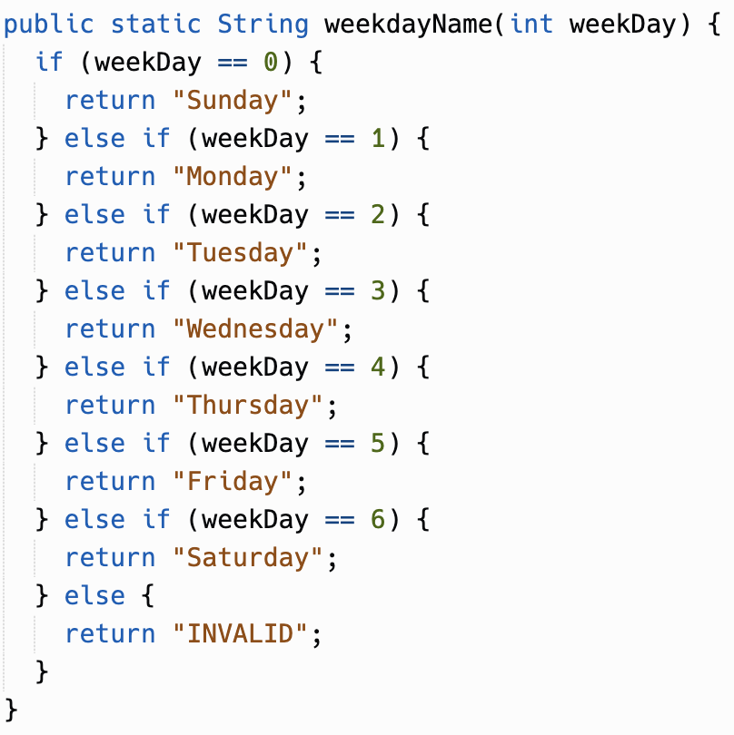
3.4 Multi-Selection: else-if
if (boolean expression 1)
statement1
else if (boolean expression 2)
statement2
else if (boolean expression 3)
statement3

Slide 64
else-if syntax
Flowchart of else-if
Does boolean expression 1 evaluate to true?
if (boolean expression 1)
statement1
else if (boolean expression 2)
statement2
else if (boolean expression 3)
statement3
No
Yes
Does boolean expression 2 evaluate to true?
No
Yes
Does boolean expression 3 evaluate to true?
Yes
Execute statement1
Execute statement2
Execute statement3

Slide 65
3.5 Compound Boolean Expressions – Logical Operators
Logical And
p && q
Evaluates boolean expressions p and q.
Evaluates to true if p and q are both true, false otherwise.
if (sunny && warm) { … }
Logical Or
p || q
Evaluates boolean expressions x and y.
Evaluates to true if p or q are true, false otherwise.
if (christmas || halloween) { … }
Logical Not
!p
Evaluates boolean expression p.
Evaluates to true if p is false.
Evaluates to false if p is true.
if (!day.equals("Sunday")) { … }
Why p and q? In logic textbooks, the "default" names for logical propositions are p and q.

Slide 66
Truth Table - &&
Truth Table - ||
Truth Table - !
p | q | p && q
true | true | true
true | false | false
false | true | false
false | false | false
p | q | p || q
true | true | true
true | false | true
false | true | true
false | false | false
p | !p
true | false
false | true

Slide 67
Short-Circuit Evaluation
p && q
p || q
Does p evaluate to true?
Does p evaluate to true?
No
Yes
Yes
No
Does q evaluate to true?
Does q evaluate to true?
No
Yes
Yes
No
true
false
false
true

Slide 68
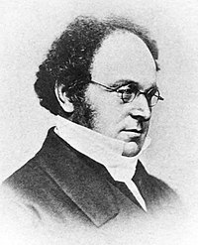
3.6 Equivalent Boolean Expressions
DeMorgan's Laws: These rules can simplify boolean expressions to make them easier to read or interpret.
!(a && b) is equivalent to !a || !b
!(a || b) is equivalent to !a && !b

Slide 69
De Morgan's Laws: Example
YOU: I'm leaving for school!
MOM: Let's make sure you have everything.
MOM: Do you have both your phone and your lunch?
(is phone && lunch true?)
YOU: No. !(phone && lunch) is true
MOM: What are you missing, your phone? Your lunch? Both?
(!phone || !lunch) is true
!(phone && lunch) = !phone || !lunch
phone | lunch | !(phone && lunch) | !phone || !lunch
F | F | !(F && F) → !F → T | !F || !F → T || T → T
F | T | !(F && T) → !F → T | !F || !T → T || F → T
T | F | !(T && F) → !F → T | !T || !F → F || T → T
T | T | !(T && T) → !T → F | !T || !T → F || F → F

Slide 70
De Morgan's Laws: Example
!(a && b) = !a || !b
You must do pull-ups AND run a mile to complete the fitness test.
if (!(completedPullUps && completedOneMileRun)) { System.out.println(“You are not yet done with your fitness test!"); }
is the same as
if (!completedPullUps || !completedOneMileRun) { System.out.println(“You are not yet done with your fitness test!”); }

Slide 71
De Morgan's Laws: Truth Tables
!(a && b) = !a || !b
!(a || b) = !a && !b
a | b | !(a && b) | !a || !b
F | F | !(F && F) → !F → T | !F || !F → T || T → T
F | T | !(F && T) → !F → T | !F || !T → T || F → T
T | F | !(T && F) → !F → T | !T || !F → F || T → T
T | T | !(T && T) → !T → F | !T || !T → F || F → F
a | b | !(a || b) | !a && !b
F | F | !(F || F) → !F → T | !F && !F → T && T → T
F | T | !(F || T) → !T → F | !F && !T → T && F → F
T | F | !(T || F) → !T → F | !T && !F → F && T → F
T | T | !(T || T) → !T → F | !T && !T → F && F → F

Slide 72
Negated Relational Expressions
For negated relational expressions, you can flip the operator and remove the !
!(c == d) is equivalent to (c != d)
!(c != d) is equivalent to (c == d)
!(c < d) is equivalent to (c >= d)
!(c > d) is equivalent to (c <= d)
!(c <= d) is equivalent to (c > d)
!(c >= d) is equivalent to (c < d)
Example:
Simplify !(x > 2 && y < 4)
Apply !(a && b) == !a || !b
!(x > 2) || !(y < 4)
Apply !(c > d) == (c <= d)
(x <= 2) || !(y < 4)
Apply !(c < d) == (c >= d)
x <= 2 || y >= 4

Slide 73
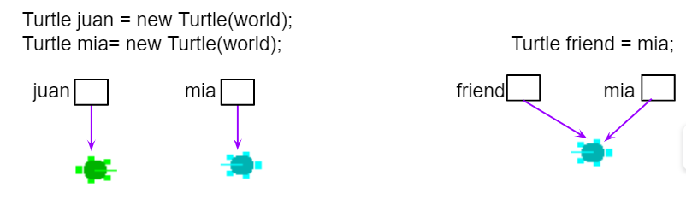
3.7 Object Equality
For object types, == and != compare whether the two sides are references to the same object… not whether anything else about the objects are equal, such as the characters in two Strings.
For Strings, remember to use equals() and not the == or != operators.

Slide 74
null means nothing is pointed to
String s; is a reference variable of type String.
A String reference, like all object references, either points to a String object instance, or is null
String s;
String s;
s
null
s = "Hello, world!"; ← s started out null, but now points to a legit string
s
"Hello, world!"
String instance

Slide 75

NullPointerException
A variable Dog dog; points to an instance of class Dog.
It starts out not pointing to any Dog, with the special value null.
You have to use new Dog to construct a Dog instance that the variable can point to.
If you don’t initialize a variable to point to a Dog instance, and you try to call a method, NullPointerException will be thrown.
Dog badDog; // badDog == null badDog.getAge(); // throws NullPointerException
Dog goodDog = new Dog(3); // goodDog points to instance goodDog.getAge(); // no problem
badDog variable
null
goodDog variable
Dog instance
age
3

Slide 76
Final Review Exercise
File System Simulator

Slide 77
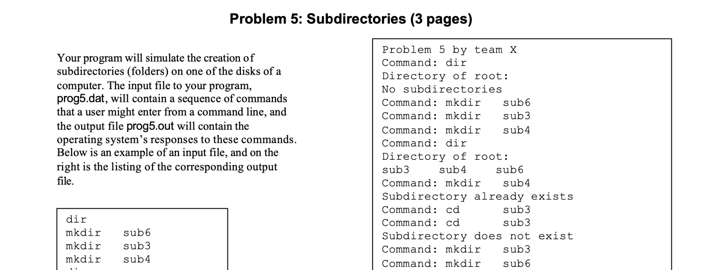
Review Exercise: File System Simulator
An actual interview question!

Slide 78
Review Exercise: File System Simulator
Directory
parentDirectory
directoryName
directories
files
File
parentDirectory
fileName
fileSize

Slide 79
Review Exercise: File System Simulator
Directory
parentDirectory
directoryName
directories
files
File
parentDirectory
fileName
fileSize
"root"
Directories
Have a name
Have a list of children Files
Have a list of children Directories
Know their parent Directory
"dog.jpg" 100
"notes"
"note1.txt" 200
"note2.txt" 300

Slide 80
Review Exercise: File System Simulator
Directory
parentDirectory
directoryName
directories
files
File
parentDirectory
fileName
fileSize
"root"
Files
Have a name
Know their parent Directory
"dog.jpg" 100
"notes"
"note1.txt" 200
"note2.txt" 300

Slide 81
Review Exercise: File System Simulator
Command | Operation
dir | Print the contents of the current directory Example Contents of /root/d2/ <d4> <d5> t7.txt 800 bytes t8.txt 900 bytes t9.txt 1000 bytes
mkdir <directory name> | Create a new directory with the name <directory name>; Fail if a directory named <directory name> already exists in the current directory

Slide 82
Review Exercise: File System Simulator
Command | Operation
mkfile <file name> <file size> | Create a new file with the name <file name> and size <file size>; Fail if a file named <file name> already exists in the current directory
cd <directory name> | Change the current directory to <directory name>; Fail if a directory named <directory name> does not exist in the current directory
up | Change the current directory to the parent of the current directory; Fail if the current directory is already the topmost directory
verify | Run tests
quit | Quit

Slide 83
Review Exercise: File System Simulator
Replit: File System Simulation
What other operations can you add?

Slide 84
Final Review - Part 2
12/9/2022

Slide 85
Final Review - Part 2
Unit 4
File System Simulator Discussion / Demos

Slide 86
4.1
The while loop

Slide 87
Iteration
Iteration, in the context of computer programming, is a process wherein a set of instructions are repeated a specified number of times or until a condition is met.
Each time the set of instructions is executed is called an iteration.
Another term for iteration is loop… the program "loops back" to an earlier step and repeats.

Slide 88
while syntax
Flowchart of while
while (boolean expression)
statement
Does boolean expression evaluate to true?
Example:
Yes
int i = 1;
while (i <= 100) {
System.out.println(i);
i++;
}
No
Execute statement
It's like an if statement that keeps repeating itself.
Like if, we recommend curly braces always.
(But Java does not require it.)
Next statement after while

Slide 89
++ and -- operators
int i = 1;
while (i <= 100) {
System.out.println(i);
i++;
}
int i = 1;
while (i <= 100) {
System.out.println(i++);
}
void printManyTimes(String s, int count) { while (count > 0) {
System.out.println(s);
count-–;
} }
void printManyTimes(String s, int count) {
while (--count >= 0) {
System.out.println(text);
} }
i++ means post-increment, so it evaluates to the current value of i, then increments it. The increment/decrement is a side effect.
Opinions differ on style here.

Slide 90
= (assignment) can be used in the condition
Your loop condition may depend on some code that repeats every iteration:
String command = getNextCommand(); while (command != null) { executeCommand(command); command = getNextCommand();
} }
The assignment operator can be used in the condition to avoid the repetition:
String command; while ((command = getNextCommand()) != null) { executeCommand(command); } }
Programmers may differ on the style here. (The first style was used in Magpie.)

Slide 91
Sentinel values
A sentinel value is a special value that tells the loop to terminate.
The code from the previous slide is an example of this:
getNextCommand returns null when there are no more commands to execute.
String command;
while ((command = getNextCommand()) != null) {
executeCommand(command);
}
}

Slide 92
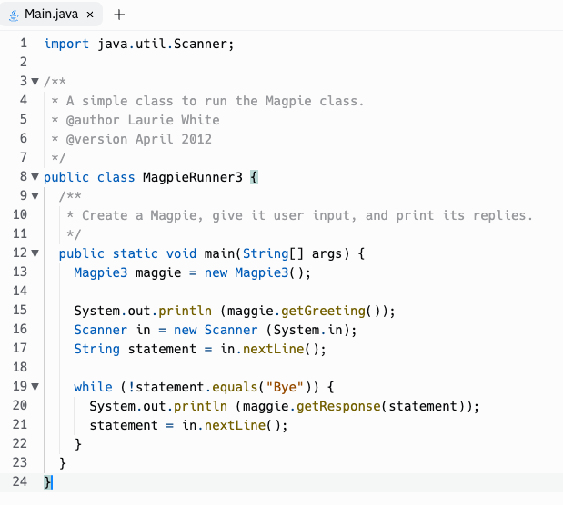
Input-controlled loops
The while loop is often used for input-controlled loops, where input is being taken from the user, or from a file on disk, or the network.
An example is the MagpieRunner, where the while loop continues until the user enters "Bye", the sentinel value which tells Magpie that no more input is coming and terminates the loop.

Slide 93
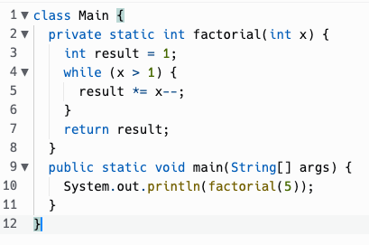
Tracing loops
x | result
5 | 1
4 | 5
3 | 20
2 | 60
1 | 120

Slide 94
do…while syntax
Flowchart of while
do
statement
while (boolean expression)
Execute statement
Sometimes, you want to check some condition AFTER the body of the loop has run, not before.
Does boolean expression evaluate to true?
Example:
String name; do {
System.out.println("Enter your name.");
name = scanner.nextLine();
} while (name.length() == 0);
Yes
No
Next statement after do…while

Slide 95
Infinite loops
void serveRequestsForever() {
while (true) {
handleNextRequest();
} }
This may seem strange, but it has its place.
Sometimes the loop isn't really infinite, but the termination condition of the loop is complicated.
There are ways to break out of a loop, even an infinite one (break, return).
There may also be unintentional infinite loops in your code that you need to fix!

Slide 96
4.2
The for loop

Slide 97
Counter-controlled loops
We looked at input controlled loops, which are often done using while.
For statements are often used to do counter-controlled loops, where the loop is repeated a specific number of times, and a numeric counter is used to track which iteration the loop is on.
However, really, any of the loop statements in Java can be used to write any possible program. Which loop to use is a matter of what you think best expresses the intent of the program.

Slide 98
for syntax
Flowchart of for
Evaluate initialization expression
for (initialization; condition; increment)
statement
Does condition evaluate to true?
Example:
Yes
int i;
for (i = 1; i <= 100; i++) {
System.out.println(i);
}
No
Execute body statement
Evaluate increment expression
Next statement after for

Slide 99
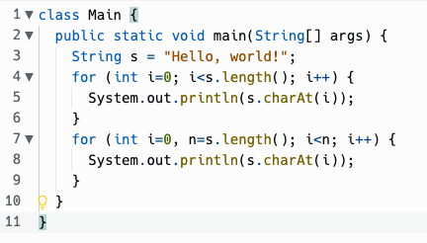
for syntax
for (initialization; condition; increment)
statement
initialization may also declare variables, even multiple variables (but only of the same type)
The scope of any variable declarations is purely the for loop itself.

Slide 100
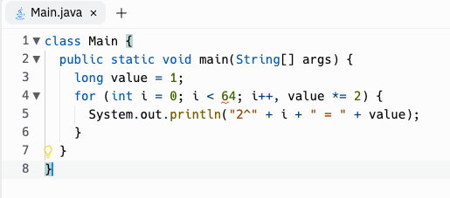
for syntax
The increment expression can use "," to update multiple variables.
And you're not limited to ++, --, although they are the most common things to see there.

Slide 101
for syntax
for (initialization; condition; increment)
statement
initialization, condition, and increment are all optional
for (;;) { … }
is an infinite loop, the same as while (true) { … }
Why would you omit initialization?
Sometimes the initialization needed takes multiple statements and can't be easily expressed in a single expression, so you do it before the for loop and omit the initialization.
Why would you omit increment?
Increment logic may similarly get complicated and be better expressed within the body of the loop.

Slide 102
for syntax
for (initialization; condition; increment)
statement
for statements are very frequently used with numeric counters, usually integers.
But they don't have to be… the expressions can be most anything.
// Cast spell to magically look east as far as possible.
for (Room room = player.getLocation();
room != null;
room = room.getEast()) { printRoomContents(room);
}
for is very flexible in this way.
Some languages like BASIC have a FOR statement that only can initialize and increment a numeric counter.

Slide 103
Getting out of a loop, or the current loop iteration
return
break
continue
You can exit a while or for loop by returning out of the enclosing method.
One student wrote this for the TruthGame pickNext method:
public int pickNext() { for (int i=1; i<=3; i++) { if (isTruth(i)) { return i; } } return -1; }
break exits a while or for loop and just moves on to the next statement after the loop.
while (true) { String command = scanner.nextLine(); if (command.equals("quit")) { break; } … } System.out.println("Well, goodbye, then!");
continue jumps back to the top of the loop and re-evaluates the condition. It's useful for skipping the body of the loop, like to ignore blank lines.
while (scanner.hasNextLine()) { String line = scanner.nextLine(); if (line.equals("")) { continue; } processNonEmptyLine(line); }

Slide 104
4.3
Looping over Strings
10/14/2022

Slide 105
Refresher: String Methods!
int length() | Returns the number of characters in a String object. | str.length()
int indexOf(String str) int indexOf(String str, int fromIndex) | Returns the index of the first occurrence of str [starting at fromIndex, if provided]. Returns -1 if not found. | str.indexOf("ing") str.indexOf("ch", 9)
String substring(int from, int to) String substring(int from) | Returns substring beginning at index from and ending at (to - 1) [or length()-1, if to isn’t provided]. | str.substring(7, 10) str.substring(3) str.substring(i, i+1)
char charAt(int index)* | Returns the character in the string at index. | str.charAt(2)
* Note that charAt is not part of AP Computer Science A Java Subset

Slide 106
String Transformations Using Loops
Many loops over strings are to transform a string into another string, e.g., remove spaces, reverse it. This can be approached in multiple ways. Here are two approaches:
Approach #1: Transform the same String variable repeatedly until you achieve the desired result.
s = "Let us remove all spaces" s ← "Letus remove all spaces" s ← "Letusremove all spaces" s ← "Letusremoveall spaces" s ← "Letusremoveallspaces"
(Remember, Java Strings are immutable, meaning they cannot be modified. When s changes, you aren't modifying the same String instance… you are repeatedly changing what the String reference variable s points to.)
Approach #2: Loop over the source String, leaving it unchanged, to build up a new result String.
s = "Let us remove all spaces" result ← "Let" result ← "Letus" result ← "Letusremove" result ← "Letusremoveall" result ← "Letusremoveallspaces"
Neither approach is always better. It depends on the problem you're solving. You may need to benchmark the code both ways to find what works better.

Slide 107
String loops with while
Example: Removes spaces from a String
public static String removeSpaces(String s) { int i = s.indexOf(" ");
// while there is a " " in the string while (i >= 0) { // Remove the " " at index by concatenating // substring up to index and then rest of the string. s = s.substring(0, i) + s.substring(i+1);
i = s.indexOf(" ");
}
return s;
}

Slide 108
When to use while vs for with strings?
Looking for a certain character or substring?
Don’t know how many times the loop needs to run?
Want to visit every character (e.g. reversing a string, checking if palindrome)?
while
for

Slide 109
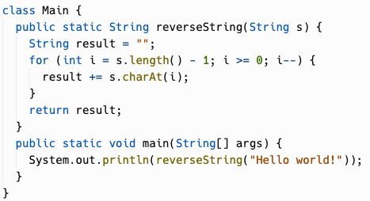
Reverse String Using for Loops

Slide 110
Nested Loops
Chapter 4.4

Slide 111
Rows and Columns
for (int i = 0; i < 5; i++) { for(int j = 0; j < 3; j++) { System.out.print(j); } System.out.println(); }
i = 0
j = 0
j = 1
j = 2
j = 0
j = 1
j = 2
The outer loop iterates through the rows
The inner loop iterates through the columns
The inner loop runs in its entirety on each iteration of the outer loop
i = 1
i = 2
j = 0
j = 1
j = 2
i = 3
j = 0
j = 1
j = 2
i = 4
j = 0
j = 1
j = 2

Slide 112
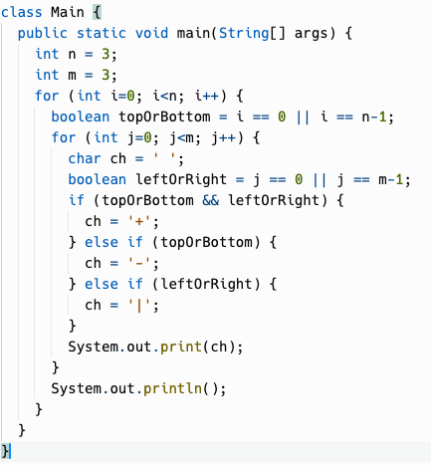
i | j | topOrBottom | leftOrRight | output
0 | 0 | true | true | +
0 | 1 | true | false | -
0 | 2 | true | true | +
1 | 0 | false | true | |
1 | 1 | false | false | (space)
1 | 2 | false | true | |
2 | 0 | true | true | +
2 | 1 | true | false | -
2 | 2 | true | true | +

Slide 113
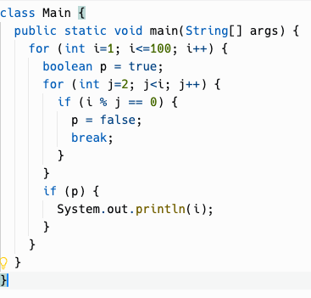
Tracing through primes
i | j | p (prime) | output
1 | 2 | true | 1
2 | 2 | true | 2
3 | 2 | true
3 | 3 | true | 3
4 | 2 | false
5 | 2 | true
5 | 3 | true
5 | 4 | true
5 | 5 | true | 5
Notes:
Still essentially a nested loop although one loop is in a method that is called
We'll trace through this loop in class

Slide 114
Runtime Analysis
Chapter 4.5
Notes:
OK, now we get to the actual subject for today, runtime analysis

Slide 115
What makes a good algorithm?
From CodeHS:
What makes a good algorithm?
Correctness
Easy to understand by someone else
Efficiency (run time and memory requirements)
Correctness refers to whether the algorithm solves the given problem.
Easy to understand can be a function of the complexity of the algorithm design, as well as how the code is laid out, use of appropriate variable names, and the use of comments.
Efficiency can be looked at in several ways, which we will explore in this section.

Slide 116
Runtime analysis
How long an algorithm takes to execute (run) is called its running time or runtime.
Runtime analysis is the process of understanding how an algorithm or complete program will perform when it is run.
It includes how long the program takes to run, as well as other factors like how much memory is consumed.

Slide 117
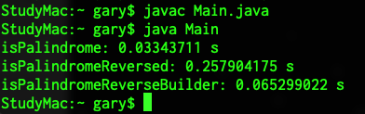
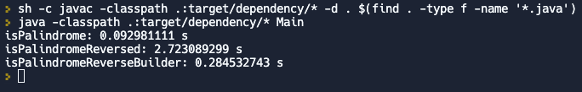
Timing Execution
System.currentTimeMillis() – milliseconds since "Unix Epoch" (January 1, 1970 00:00:00 UTC time zone). This is wall clock time… if you adjust the date/time on your computer, the value will change.
System.nanoTime() – nanoseconds since an arbitrary point in time (maybe since CPU booted). Independent of "wall clock" … it will continue increasing even if you futz with computer's date and time.
Different computers will give you different results, so timing benchmarks are only valid on the same hardware.
A lot of other stuff can be happening in other processes on a modern computer.
Different programming languages have different performance characteristics.
Even the same programming language may behave differently in different environments.

Slide 118
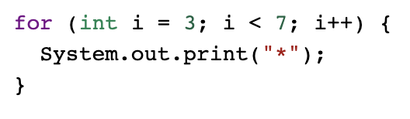
Statement Execution Count
Getting an absolute number of statements executed is tricky, and some of the things we may want to count are actually just expressions, not full statements.
Here, one way we might do it is to "point" it as follows:
int i = 3; counts as 1 point This part repeats for i=3, 4, 5, 6: i < 7 counts as 1 point System.out.print("*") counts as 1 point i++ counts as 1 point 1 + 3 * 4 = 13 "statements" total
There could be different counting methods here. On the AP exam, you'll probably be asked something more like: How many times is System.out.print called in this loop? That is, count how many times a specific statement is executed.

Slide 119


Loop Execution Count
You can use a trace table to figure out how many times a loop executes. But, you may be able to shortcut that just looking at it.
With a < condition, the number of iterations is (ending value - starting value) = 7 - 3 = 4 iterations.
When a <= is involved, the number of iterations is (ending value - starting value + 1) = 5 - 1 +1 = 5 iterations.
Both of these shortcuts assume the increment expression is just adding 1 to the counter.

Slide 120
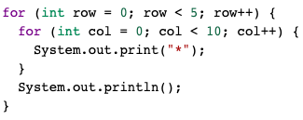
Loop Execution Count
For nested loops: The number of times a nested for loop body is executed is the number of times the outer loop runs multiplied by the number of times the inner loop runs (outer loop runs * inner loop runs).

Slide 121
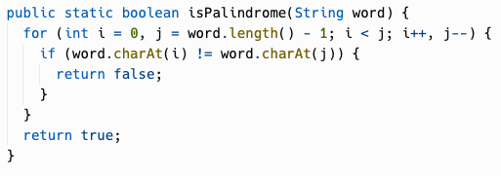
Best and worst case
Let's count the loop executions in this implementation of isPalindrome.
The loop execution count depends on the input.
The best case is a zero-length string. Next, a one-letter string. Next, the first and last letters do not match, which would be a loop execution count of 0 (but a statement execution count of 3, for the init expression, condition check, and return statement.)
The worst case is… if the string is really a palindrome, and we have to check every pair of characters! That would be word.length() / 2 loop executions.

Slide 122
Final Review Exercise
File System Simulator

Slide 123
File System Simulator
Some Thoughts So Far
ArrayList versus Array to manage child lists of Files and Directories
Don't assume a limit on the number of Files or Directories!
The children are of type File and Directory (not String)
Directory.directoryExists == (Directory.getDirectory(directoryName) != null);
Directory.fileExists == (Directory.getFile(fileName) != null);
The dir command should list child Files and child Directories
Are there any questions?
Does anyone have any new functionality that they added that they would like to show?

Slide 124
Final Review - Part 3
12/12/2022

Slide 125
Final Review - Part 3
Unit 5
Unit 6
File System Simulator Discussion / Demos

Slide 126
5.1
Anatomy of a Java Class

Slide 127
Definitions
Class - Blueprint for an object; instructions for how construct an object. There can be ONLY ONE of these -> "Dog"
Object - A particular instance of a class; use the new operator to create an object instance from a Class. There can be MANY of these -> "A 3 year-old German Shepherd named Roscoe", "A 1 year-old Golden Retriever named Lucy"
Properties and Methods - Properties are attributes (name, age, breed) and Methods are operations (play, eat, sleep); and each can be either public (available outside the Object) or private (available from only the inside of an Object)

Slide 128
Instance Variables
Also known as attributes, properties, or fields
Holds the data of an object
Every Object instance has their own values for these properties
Dog scout = new Dog("Scout", 10); Dog bailey = new Dog("Bailey", 5);
scout.name.equals("Scout") == true bailey.name.equals("Bailey") == true scout.name.equals(bailey.name) == false

Slide 129
Instance Methods
Define the behavior generically in the Class
So that it can be used by every Object instance
public void feedDog() { System.out.println("Gave " + name + " a bowl of food."); }
Dog scout = new Dog("Scout", 10); Dog bailey = new Dog("Bailey", 5);
scout.feedDog(); "Gave Scout a bowl of food." bailey.feedDog(); "Gave Bailey a bowl of food."

Slide 130
Private vs Public
Private
An instance variable or method that can only be accessed within the class
On the AP Exam all instance variables should be private
Some methods can be private if they are only used internally
Public
An instance variable or method that can be accessed outside of a class like in the main method
Most methods are public

Slide 131

Object-Oriented Design
Data Encapsulation
A design philosophy used by programmers when developing larger programs
Decide what classes you’ll need to solve a problem
Define the data (instance variables) and functionality (methods) for the classes
Utilize classes and objects to solve your problem
Data (instance variables) and the code acting on it (methods) are wrapped together in a single implementation and the details are hidden.
Data is safe from harm by keeping it private

Slide 132
5.2 & 5.3
Constructors, Comments, and Conditions

Slide 133
The Anatomy of a Constructor
Things to keep in mind:
The Constructor name (in red) must always match the name of the class (in blue)
Always prepend the public keyword before your constructor name
Constructors have no return type. Not even void!
The constructor definition is often included before other method definitions (but is not required)
Instance variables are often assigned values within a Constructor; But they can also be intialized in place (i.e. private boolean isAlive = true;)
public class ClassName { // Instance Variable Declarations
private String name;
private int age;
private boolean isAlive = true; // Constructor - same name as Class, no return type public ClassName(String initName, int initAge) { name = initName;
age = initAge;
} // Other methods ... }

Slide 134
Types of Constructors
Default Constructor
No-Argument Constructor
Parameterized Constructor
Overloaded Constructors
Automatically generated by the Java compiler when you do not supply a Constructor
Does not do any kind of specialized initialization of the Instance beyond whatever inplace variable initialization that exists
Instance variables without inplace initialization will default to something "reasonable"
int -> 0
boolean -> false
String -> null
Object -> null
public class Person {
// No constructor defined
// Java creates Default Constructor
}

Slide 135
Types of Constructors
Default Constructor
No-Argument Constructor
Parameterized Constructor
Overloaded Constructors
A Constructor you define that takes no arguments
Can perform any kind of initialization that the the Instance requires
Every Instance is initialized exactly the same
No values can be passed in during new to customize the Instance
public class Person
{
private String name;
private int age;
public Person() {
name = "Billy";
age = 25;
}
}
When you define a Constructor (any kind) Java will NOT create a Default Constructor!

Slide 136
Types of Constructors
Default Constructor
No-Argument Constructor
Parameterized Constructor
Overloaded Constructors
A Constructor you define that takes arguments
Can perform any kind of initialization that the the Instance requires
Each Instance is initialized individually based on the values passed into new
public class Person
{
private String name;
public Person(String initName) {
name = initName;
}
}

Slide 137
Types of Constructors
Default Constructor
No-Argument Constructor
Parameterized Constructor
Overloaded Constructors
A Class may have multiple Constructors
Each Constructor must be named the same as the Class; have no return type; and have a distinct set of parameters (types)
These are useful when you want to provide default values for some Instance variables - While allowing other Instance variables to be set via new
public class Person
{
private String name;
private int age;
public Person() {
name = "Name unknown"; }
public Person(String initName) {
name = initName;
age = 30;
}
public Person(String initName, int initAge) {
name = initName;
age = initAge;
}
}

Slide 138
Comments
Comments are a way for you to annotate your code
This is text in your program that is never run by Java and is added for the benefit of the person reading the code
You can also "comment out" a block of code during development to assist in the development or debugging process
There are 3 ways to write comments in Java

Slide 139
Types of Comments
Single-Line Comment
Multi-Line Comment
Documentation Comment
A single-line comment starts with a double forward-slash (//)
Can start anywhere - i.e. does not need to be in column 0
All characters following the double forward-slash are ignored until newline or end of file thisCodeWillRun(); // thisCodeWillNotRun(); thisCodeWillRun(); thisCodeWillRun(); // woo-hoo!

Slide 140
Types of Comments
A multi-line comment starts with a forward-slash asterisk (/*)
Can begin anywhere - i.e. does not need to be in column 0
All characters - including newlines - are considered part of the comment until a asterisk forward-slash (*/) is encountered
Your editor may have a key command that automatically converts a block of code into a multi-line comment /* thisCodeWillNotRun(); thisCodeWillNotRun(); */
/* thisCodeWillNotRun(); */ thisCodeWillRun(); /* woo-hoo! */
Single-Line Comment
Multi-Line Comment
Documentation Comment

Slide 141
Types of Comments
A variant of the multi-line comment syntax - Documentation Comments start with a forward-slash asterisk asterisk (/**)
Typically found just prior to the definition of a function or method
All characters - including newlines - are considered part of the Documentation Comment until a asterisk forward-slash (*/) is encountered
Within a Documentation Comment - other standard components may be supported /** * Documentation comment * */ myMethod()
Single-Line Comment
Multi-Line Comment
Documentation Comment

Slide 142
Preconditions and Postconditions
DEFINITELY on AP exam

Slide 143
Preconditions and Postconditions
Preconditions and postconditions are a "contract" that describes what a method requires about its inputs, and what it promises as output.
Precondition
Postcondition
index must be >= 0
and < length of string
public char charAt(int index);
character at index index will be returned
The caller must satisfy this requirement when calling charAt.
In return, the desired character will be returned.

Slide 144
Preconditions
Preconditions are part of the method's documentation, and may exist only as comments.
There is no expectation that the method will check to ensure preconditions are satisfied.
They may or may not be enforced by the method's code – the programmer using the method should read the documentation and understand the "contract" the method offers.
/**
* Precondition: num2 is not zero.
* Postcondition: Returns the quotient of num1 and num2.
*/
public double divide(double num1, double num2)
{
return num1 / num2;
}

Slide 145
Who enforces preconditions?
Sometimes preconditions ARE enforced by the method's code.
An actual implementation of Java's String.charAt:
Here, an exception is thrown if the precondition is not satisfied.
Throwing an exception in Java is a common way to handle failed preconditions.
public char charAt(int index) { if ((index < 0) || (index >= value.length)) { throw new StringIndexOutOfBoundsException(index); } return value[index]; }

Slide 146
Postconditions
A postcondition is a condition that is true after running the method. It is what the method promises to do.
Postconditions describe the outcome of running the method, for example what is being returned or the changes to the instance variables.
Examples:
String.compareTo() The method returns 0 if the string is equal to the other string. A value less than 0 is returned if the string is less than the other string (less characters) and a value greater than 0 if the string is greater than the other string (more characters).
Math.random Returns a double value with a positive sign, greater than or equal to 0.0 and less than 1.0.

Slide 147
5.4 & 5.5
Accessor Methods
and Mutator Methods

Slide 148
Creating Classes
public methods used to provide read-only access to private instance variables within the Object
Sometimes these are called "get methods" or "getters"
These public methods have a return type that matches the type of the private variable being returned
Accessor methods are commonly named get+VariableName and do not have parameters
Variables & Methods
Public vs Private
Constructors
Accessor Methods
Mutator Methods
public class Person
{
private String name;
public Person(String initName) {
name = initName;
}
public String getName() {
return name;
}
}

Slide 149
Creating Classes
public methods used to modify internal private instance variables
Sometimes these are called "set methods" or "setters"
These public methods typically have a void return type and a parameter that matches the type of the private instance variable being modified
Mutator methods are commonly named set+VariableName and have a single parameter
Variables & Methods
Public vs Private
Constructors
Accessor Methods
Mutator Methods
public class Person
{
private String name;
public Person(String initName) {
name = initName;
}
public void setName(String newName) {
name = newName;
}
}

Slide 150
5.6: Writing Methods

Slide 151
Methods
We have already covered about HOW to create Methods - but we have not spent much time talking about WHEN you should consider moving code into a Method
Some of the WHENs
You have the same (or very nearly the same) block of code written in multiple places
You want to reduce complexity (improve development velocity / reduce code brittleness)
You want to write tests for a block of code
You have Methods that are excessively long (more than a single page)

Slide 152
Method Parameters: Pass by Value / Pass by Reference
Parameters passed into Methods behave differently if they are primitive types or Object references
Primitive Types (byte, short, int, long, float, double, boolean, char)
A copy is made when the Method is invoked for use during the life of the Method
The Method cannot alter the value of the variable (passed as a parameter) that exists in the caller of the Method
int age = 16; Person p = new Person(age); // age is guaranteed to still be 16 public class Person { public Person(int initAge) { // initAge is a COPY of age initAge = 20; // does not alter the value of age in the caller } }
int
age
16
int
Person.Person() {
initAge
20
}

Slide 153
Method Parameters: Pass by Value / Pass by Reference
Object Types / Classes
A reference to the Object is passed into the Method
The Method can alter the internal value of the Object passed as a parameter; And the caller can see these changes when it access the Object
int age = 16; Person p = new Person(age); // p.age == 16 Student s = new Student(p); // p.age == 20 public class Student { public Student(Person person) { // person is a REFERENCE to the same object in the caller person.age = 20; // alters the Person passed in from the the caller } }
Person
p
age: 20
Student.Student() {
person
}

Slide 154
Method Parameters: Pass by Value / Pass by Reference
Object Types / Classes
A reference to the Object is passed into the Method
The Method can alter the value of the variable (passed as a parameter) that exists in the caller of the Method - RARELY USED / NOT A BEST PRACTICE
Person p = new Person(); p.age = 16; Student s = new Student(p); // p.age now equals 20 - LIKELY UNEXPECTED BEHAVIOR public class Student { public Student(Person person) { // person is a REFERENCE to the same object in the caller person.age = 20; // alters the Person passed in from the the caller } }

Slide 155
Sections 5.7, 5.8, 5.9
Statics
Scope and Access
this

Slide 156
Statics
Static variables & methods belong to Classes - not Instances of a Class
There is only one copy of a static variable & method
They can be public or private
Static variables & methods are accessed using the name of the class to which they belong and a dot (.) With a couple of exceptions: Statics accessing statics; And static imports
Math.PI
Math.random()
Math.sqrt()
The main() method is a static method - It is only ever run one time for a program - And the JVM needs to run it without creating an Instance of a Class

Slide 157
Statics
Person.getNumPeople(); A> 0
Statics can directly access other Statics
Statics cannot directly access non-Statics
Non-Statics can directly access Statics
class Person { private static int numPeople = 0; private String name; public Person(String initName) { numPeople++; name = initName; } public static int getNumPeople() { // System.out.println(name); return numPeople; } public void report() { System.out.println(name + " is one of " + numPeople + " people"); } }

Slide 158
Statics
public static int getNumPeople() { // System.out.println(name); return numPeople; }
Statics can directly access other Statics
Statics cannot directly access non-Statics
Non-Statics can directly access Statics
class Person { private static int numPeople = 0; private String name; public Person(String initName) { numPeople++; name = initName; } public static int getNumPeople() { // System.out.println(name); return numPeople; } public void report() { System.out.println(name + " is one of " + numPeople + " people"); } }

Slide 159
Statics
Person p1 = new Person("Julie"); Person p2 = new Person("Bobby"); p1.report() B> Julie is one of 2 people
p1.getNumPeople();
C> 2
Statics can directly access other Statics
Statics cannot directly access non-Statics
Non-Statics can directly access Statics
class Person { private static int numPeople = 0; private String name; public Person(String initName) { numPeople++; name = initName; } public static int getNumPeople() { // System.out.println(name); return numPeople; } public void report() { System.out.println(name + " is one of " + numPeople + " people"); } }

Slide 160
Scope and Access Control
Class Level Scope Instance and static variables inside a Class.
Method Level Scope Local variables (including parameter variables) inside a method.
Block Level Scope Loop variables and other local variables defined inside of blocks of code with { }
public class Person { private String name;
private String email; public void print(int length) { for (int i = 0; i < length; i++) { System.out.println(name.charAt(i)); } } }

Slide 161
Scope and Access Control
Class Level Scope Instance and static variables inside a Class.
Method Level Scope Local variables (including parameter variables) inside a method.
Block Level Scope Loop variables and other local variables defined inside of blocks of code with { }
public class Person { private String name;
private String email; public void print(int length) { for (int i = 0; i < length; i++) { System.out.println(name.charAt(i)); } } }

Slide 162
Scope and Access Control
Class Level Scope Instance and static variables inside a Class.
Method Level Scope Local variables (including parameter variables) inside a method.
Block Level Scope Loop variables and other local variables defined inside of blocks of code with { }
public class Person { private String name;
private String email; public void print(int length) { for (int i = 0; i < length; i++) { System.out.println(name.charAt(i)); } } }

Slide 163
this (keyword)
Within an Instance method of a Class - this refers to the current Instance (and refers to the Instance being created in a Constructor)
Static methods cannot refer to this (since there is no Instance when using static methods)
class Person { private static int numPeople = 0; private String name; public Person(String name) { numPeople++; this.name = name; } public static int getNumPeople() { return numPeople; } public void report() { System.out.println(name + " is one of " + numPeople + " people"); } }

Slide 164
this is a reference to the current object instance
class Student { private String name; private int age;
Student(String name, int age) { this.name = name; this.age = age; } public String toString(){ return name; } } class HelloWorld { public static void main( String args[] ) { Student s = new Student("Jane",16); System.out.println(s.toString()); //”Jane” System.out.println(s); //Also ”Jane” } }
Student s
Call Stack
VERY common
pattern.
"Jane"
name
s.toString()
16
age
this
Q: What's the difference here between name and this.name?
main(new String[]{})
args
new String[] {}
s

Slide 165
Unit 6: Arrays

Slide 166
6.1 Arrays
Arrays are a "table" of values of the same type. Each value can be get/set using its 0-based index.
For any Java type, you can use type[] for an Array of that type.
The length of an Array is decided when it is created, and cannot change.
String[] names = {"Abe", "Bob", "Cat", "Dave", "Eric"};
String[]
names
"Abe"
"Bob"
"Cat"
"Dave"
"Eric"
0
1
2
3
4
names.length: 5

Slide 167
Arrays - Creation
Arrays are created with an initializer list or the new operator:
boolean[] answers = {true, false, false, true}; int[] scores = {100, 84, 95, 78}; double[] prices = new double[20]; String[] questions = new String[5]; int numStudents = 10; Student[] students = new Student[numStudents];
If you declare an Array variable and do not initialize it, it will default to null, like other object types.
Student[] students; // Contains null

Slide 168
Arrays: initialized with default values, unless specified
boolean[] answers = new boolean[4];
boolean[] answers = {true, false, false, true};
booleans
booleans
answers
true
false
false
true
answers
false
false
false
false
0
1
2
3
0
1
2
3
answers.length: 4
answers.length: 4
int[] scores = new int[4];
int[] scores = {100, 84, 95, 78};
ints
ints
scores
0
0
0
0
scores
100
84
95
78
0
1
2
3
0
1
2
3
scores.length: 4
scores.length: 4

Slide 169
Arrays of object type are initialized to null
String[] questions = new String[5];
Student[] students = new Student[10];
Strings
questions
null
null
null
null
null
0
1
2
3
4
questions.length: 5
Students
students
null
null
null
null
null
null
null
null
null
0
1
2
3
4
5
6
7
8
9
students.length: 10
students[0] = new Student();
Student

Slide 170
Re-assigning Array variables
Array variables are just like any other object typed variable:
boolean[] answers = {true, false, false, true};
That is, you can later point them to a different object (array):
answers = new boolean[4];
The new operator also can take an initializer list.
answers = new boolean[] { true, false, false, true };

Slide 171
Array length and the [] operator
array.length | array[index] | array[index] = value
A public final instance variable which returns the length of the array. Note that it's a variable (array.length), not a method like String.length() | Evaluates to the index'th element of array. Indices are 0-based. If index is out of bounds, ArrayIndexOutOfBoundsException is thrown. | Sets the index'th element of the array to value. Indices are 0-based. If index is out of bounds, ArrayIndexOutOfBoundsException is thrown. Remember, the length of an array cannot change.
Example: boolean[] answers = {true, false, false, true}; System.out.println(answers.length); A> 4 | Example: int[] scores = {32, 5, 87, 44}; System.out.println(scores[2]); B> 87 | Example: int[] scores = {100, 84, 95, 78}; scores[1] = 48; System.out.print(scores[1]); C> 48

Slide 172
6.2 Traversing Arrays with for loops
for loops are frequently used to traverse (visit every element) of an array.
The most common pattern is:
int[] scores = {95, 100, 91, 85 };
for (int i = 0; i < scores.length; i++) {
System.out.println(scores[i]);
}
The range of valid Array indexes (for non-empty Arrays) is 0 to Array.length - 1, so starting at i=0 and looping on i<array.length will loop over every element.

Slide 173
Traversing arrays all different ways
Reverse order | Subarray | Skipping elements
int[] scores = {95, 100, 91, 85 }; for (int i=scores.length-1; i>=0; i--) { System.out.println(scores[i]); } | int[] scores = {95, 100, 91, 85 }; for (int i=startIndex; i<endIndex; i++) { System.out.println(scores[i]); } Note: In this example, endIndex is exclusive, like String.substring. The interval [startIndex, endIndex) will be returned. | int[] scores = {95, 100, 91, 85 }; // Print every other element for (int i=0, n=scores.length; i<n; i += 2) { System.out.println(scores[i]); }

Slide 174
Traversing Arrays with for loops
You can use a for loop to traverse an Array from back to front!
int[] scores = {95, 100, 91, 85 };
for (int i = scores.length - 1; i >= 0; i--) {
System.out.println(scores[i]);
}
...or to traverse any arbitrary range of elements
int[] scores = {95, 100, 91, 85 };
for (int i = 1; i <= 2; i++) {
System.out.println(scores[i]);
}

Slide 175
6.3 Traversing Arrays with for-each loops
An alternate way to loop through Objects that support the Iterable interface
for (type arrayItemVariable : arrayVariable) { arrayItemVariable is a copy of arrayVariable[0] arrayItemVariable is a copy of arrayVariable[1] arrayItemVariable is a copy of arrayVariable[...] arrayItemVariable is a copy of arrayVariable[arrayVariable.length-1] then the loop terminates }

Slide 176
Traversing Arrays with for-each loops
for (type arrayItemVariable : arrayVariable) { arrayItemVariable resolves to arrayVariable[...] }
String[] colors = {"red", "orange", "purple"}; System.out.println("begin"); for(String color: colors){ System.out.println(" " + color); } System.out.println("end");
Output:
begin
red
orange
purple end

Slide 177

Traversing Arrays with for-each loops
The type of the for-each variable MUST match the type of the values stored in the Array
String[] colors = {"red", "orange", "purple"}; for(int color: colors){ System.out.println(" " + color); }
Note: color must be of type String since colors is an Array that contains Strings

Slide 178
Comparing for and for-each loops
for
Direct access to any element in the Array, in any order, using index and []
You always know the index – so using parallel Arrays is easy!
Code has more "boilerplate" and may require more variable declarations
Can change the value of an Array element during the loop
Many iteration possibilities: Reverse order, skip elements, visit only a sub-array, etc.
for-each
Sequential access to the elements in the Array - must always go from first to last
You do not know the index – so using Parallel Arrays requires tracking it yourself
Code is more concise and may require less variable declarations
Cannot change the value of an Array element during the loop
More limited in functionality, but the code is "short and sweet."
Might be slower since it's Iterable/Iterator under the hood ... benchmark if unsure

Slide 179
6.4 Common Array Algorithms
Here are some common algorithms that you should be familiar with for the AP CS A exam:
Determine the minimum or maximum value in an array
Compute a sum, average, or mode of array elements
Search for a particular element in the array
Determine if at least one element has a particular property
Determine if all elements have a particular property
Access all consecutive pairs of elements
Determine the presence or absence of duplicate elements
Determine the number of elements meeting specific criteria
Shift or rotate elements left or right
Reverse the order of the elements

Slide 180
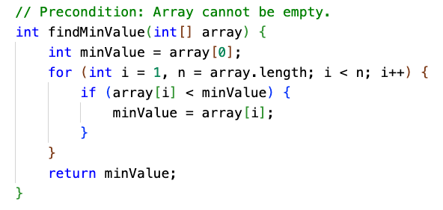
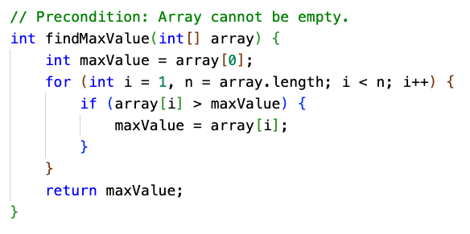
Minimum and Maximum Value
These require a "tracking value" for the smallest or largest value found so far.
25 | 70 | 9 | 3 | 15 | 16 | 19
minValue =
25
25
9
3
3
3
3
One trick is to "seed" the tracking value with the first element, and skip it in the loop.

Slide 181
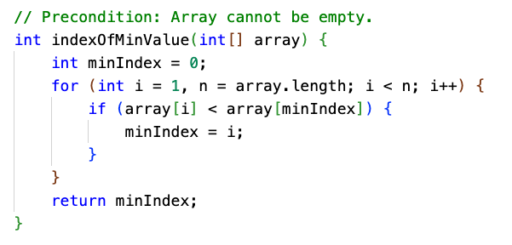
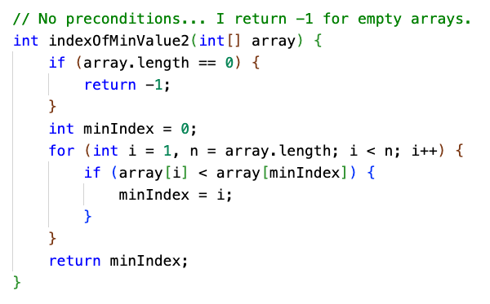
Minimum and Maximum Value
With a little modification, you could return the array index instead of the value.

Slide 182
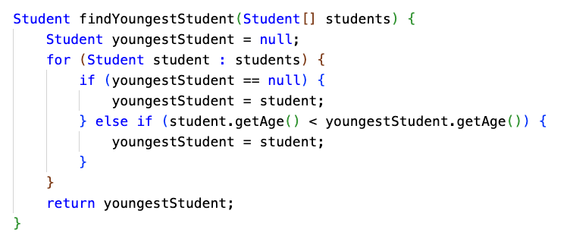
Minimum and Maximum Value of Objects
You might be dealing with an array of something other than numbers.

Slide 183
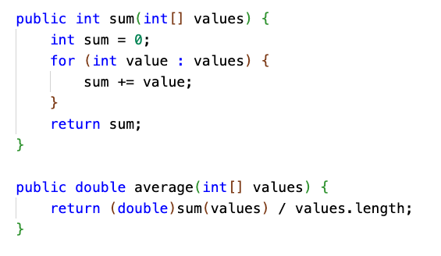
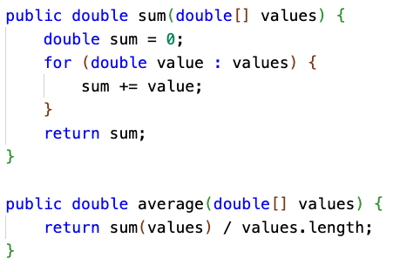
Sum and Average
If dealing with ints, remember to cast to double when calculating average. (Also known as the arithmetic mean.)

Slide 184
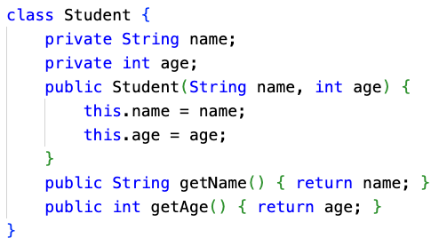
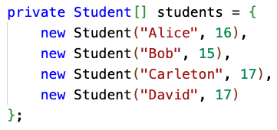
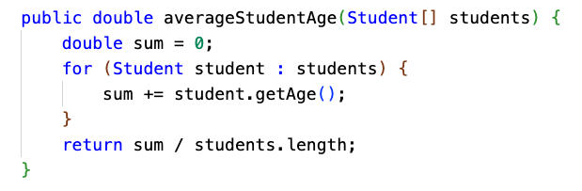
Calculations aren't always over int[] or double[]...
What if you are calculating the average age of a class of Students?

Slide 185
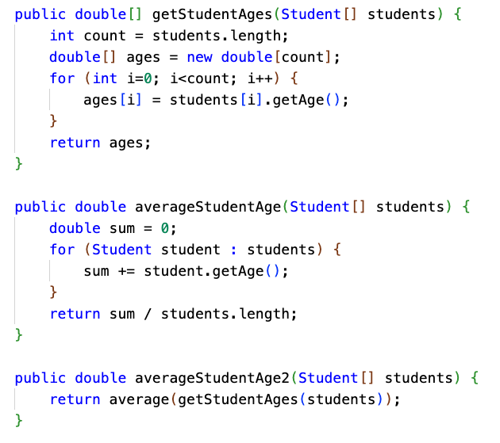
Transforming arrays to do calculations
It can make sense to transform an Array into another Array, and then do a calculation.
Creating the ages Array takes time and memory... but it can make sense, depending on the situation.
The age data might be used more than once
You might be interfacing with code, such as a third-party library, that doesn't know about Students
Your math-heavy code stays in its "domain" ... it only needs to know about math, not Students, and can be reused for things other than Students.
Performance and memory usage may not be critical

Slide 186
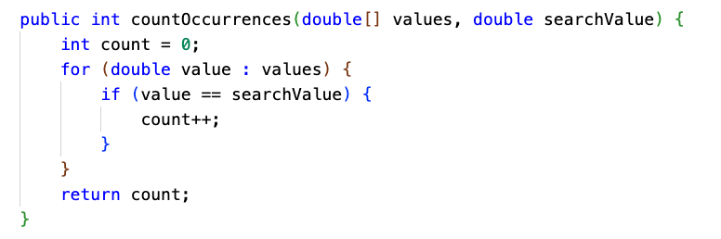
Determine number of elements meeting specific criteria

Slide 187
Mode: Most frequently occurring value
We can calculate the mode using a nested loop. For each element, count the number of occurrences of that element, and track which element has the maximum number of occurrences.
17 | 17 | 9 | 9 | 9 | 9 | 1 | 17 | 19 | 3 | 3 | 5
frequency (of value at current index)
3 | skip | 4 | skip | skip | skip | 1 | 3 | 1 | 2 | skip | 1
modeValue
17 | 17 | 9 | 9 | 9 | 9 | 9 | 9 | 9 | 9 | 9 | 9
modeFrequency
3 | 3 | 4 | 4 | 4 | 4 | 4 | 4 | 4 | 4 | 4 | 4

Slide 188
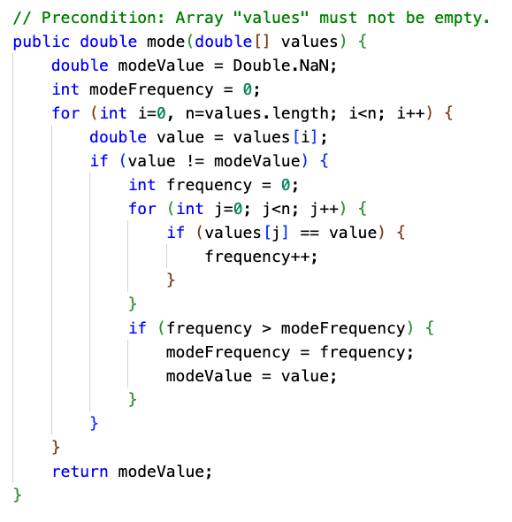
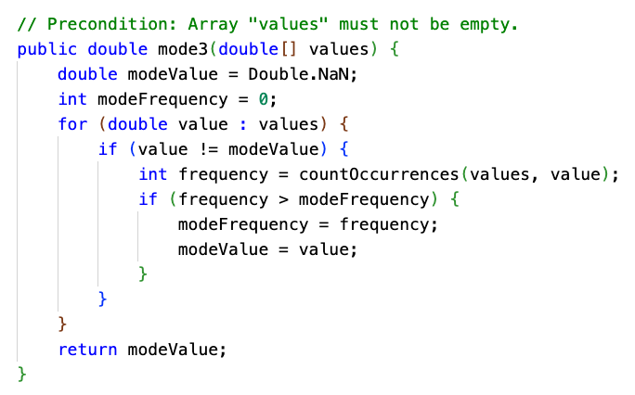
Mode of unsorted array

Slide 189
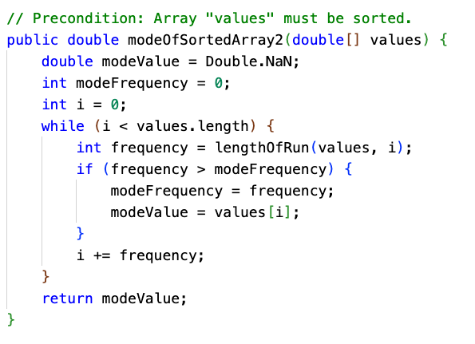
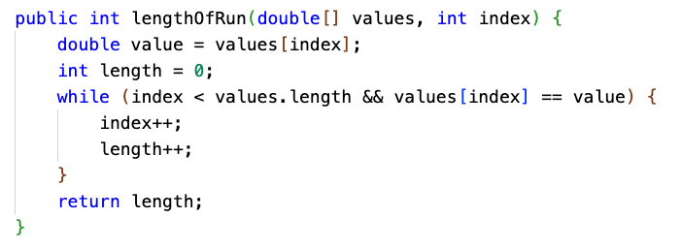
Mode of sorted array, with helper method
1 | 1 | 2 | 2 | 2 | 3 | 3 | 3 | 3 | 4 | 4 | 5
lengthOfRun(values, index)
2 |  | 3 |  |  | 4 |  |  |  | 2 |  | 1

Slide 190
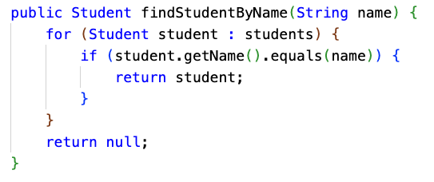
Search for a particular element in the array
This is known as linear search, the simplest (and least efficient) of search algorithms. We'll learn others later.

Slide 191
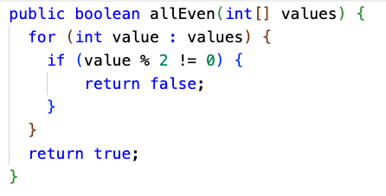
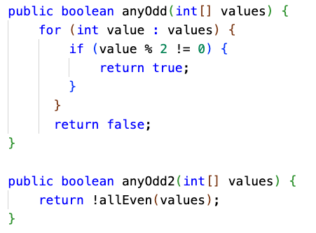
Determine if all elements have a particular property
Determine if at least one element has a particular property
These algorithms are the inverse of each other:
If all of the numbers all even, then there are not any odd numbers.
If there are any odd numbers, then not all of the numbers are even.

Slide 192
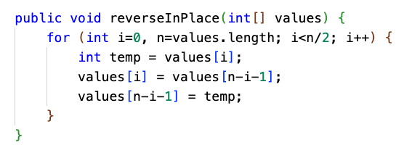
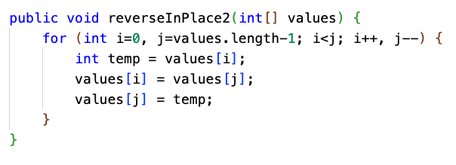
Reverse an array (in place)
The top implementation is fine, but the bottom one uses i and j instead of just i.
I find it easier to reason about what this algorithm is doing by having two index counters, "racing" toward each other from each end of the array.
Computers have many registers for storage of frequently used variables, so there is really no additional cost to having two variables instead of one. It can be even faster, since less arithmetic is performed.

Slide 193
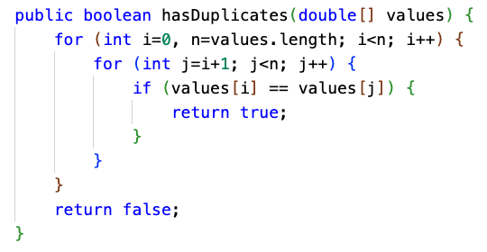
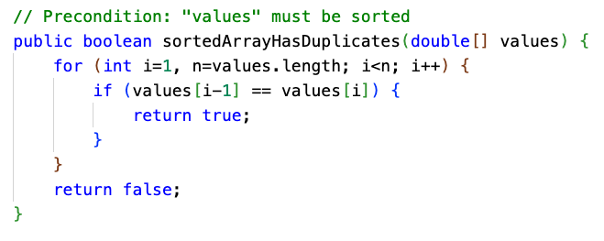
Check for presence of duplicate elements

Slide 194
Shift or rotate an array
Here, we rotate an array of numbers to the left by 1 position.
a[i] = a[i+1] for all i. The first element gets moved to the last position.
0 | 1 | 2 | 3 | 4 | 5 | 6 | 7 | 8 | 9 | 10 | 11
1 | 2 | 3 | 4 | 5 | 6 | 7 | 8 | 9 | 10 | 11 | 12
0 | 1 | 2 | 3 | 4 | 5 | 6 | 7 | 8 | 9 | 10 | 11
2 | 3 | 4 | 5 | 6 | 7 | 8 | 9 | 10 | 11 | 12 | 1

Slide 195
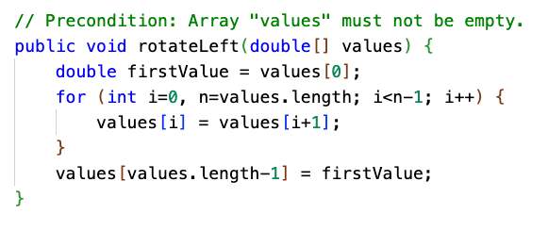
Rotate array to the left, in place
0 | 1 | 2 | 3 | 4 | 5 | 6 | 7 | 8 | 9 | 10 | 11
1 | 2 | 3 | 4 | 5 | 6 | 7 | 8 | 9 | 10 | 11 | 12
0 | 1 | 2 | 3 | 4 | 5 | 6 | 7 | 8 | 9 | 10 | 11
2 | 3 | 4 | 5 | 6 | 7 | 8 | 9 | 10 | 11 | 12 | 1

Slide 196
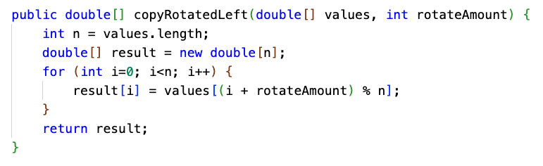
Rotate array to the left multiple positions, returning copy
Here's another instance where the % operator is very useful.

Slide 197
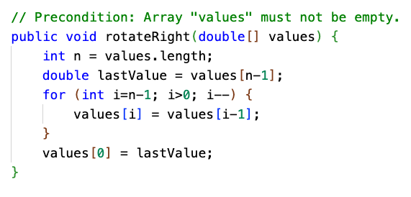
Rotate array to the right, in place
0 | 1 | 2 | 3 | 4 | 5 | 6 | 7 | 8 | 9 | 10 | 11
1 | 2 | 3 | 4 | 5 | 6 | 7 | 8 | 9 | 10 | 11 | 12
0 | 1 | 2 | 3 | 4 | 5 | 6 | 7 | 8 | 9 | 10 | 11
12 | 1 | 2 | 3 | 4 | 5 | 6 | 7 | 8 | 9 | 10 | 11

Slide 198
Final Review Exercise
File System Simulator

Slide 199
File System Simulator
Some Thoughts So Far
Seeing additional System.out statements letting the user know what is going on 👍
Including a new help command
Are there any questions?
Does anyone have any new functionality that they added that they would like to show?
find(fileName) - Ryan

